Slide 1
UNIT IV - OPTOELECTRONIC MODULATORS, INTERCONNECTS AND SWITCHES
Electro-Optic Modulator: Principles, Electro optic effect - Single waveguide electro optic modulators - Dual channel waveguide electro optic modulator - Electro optic modulator employing reflection or Diffraction- Integrated Optical Modulators: Phase and polarization modulation - Mach Zehnder modulator, Coupled waveguide modulator- Acousto-Optic Modulator: Principles, Acousto optic effect, Raman Nath and Bragg type modulators- Performance characteristics, Acousto optic frequency shifters- Faraday Rotation - Optical Isolators- Nonlinear Optics- Second Harmonic Generation - Optical Interconnects- Optical gates- Photonic Switches

Slide 2

Faraday Rotation
Free space optical isolators using Faraday rotation
Courtesy of Thorlabs

Slide 3
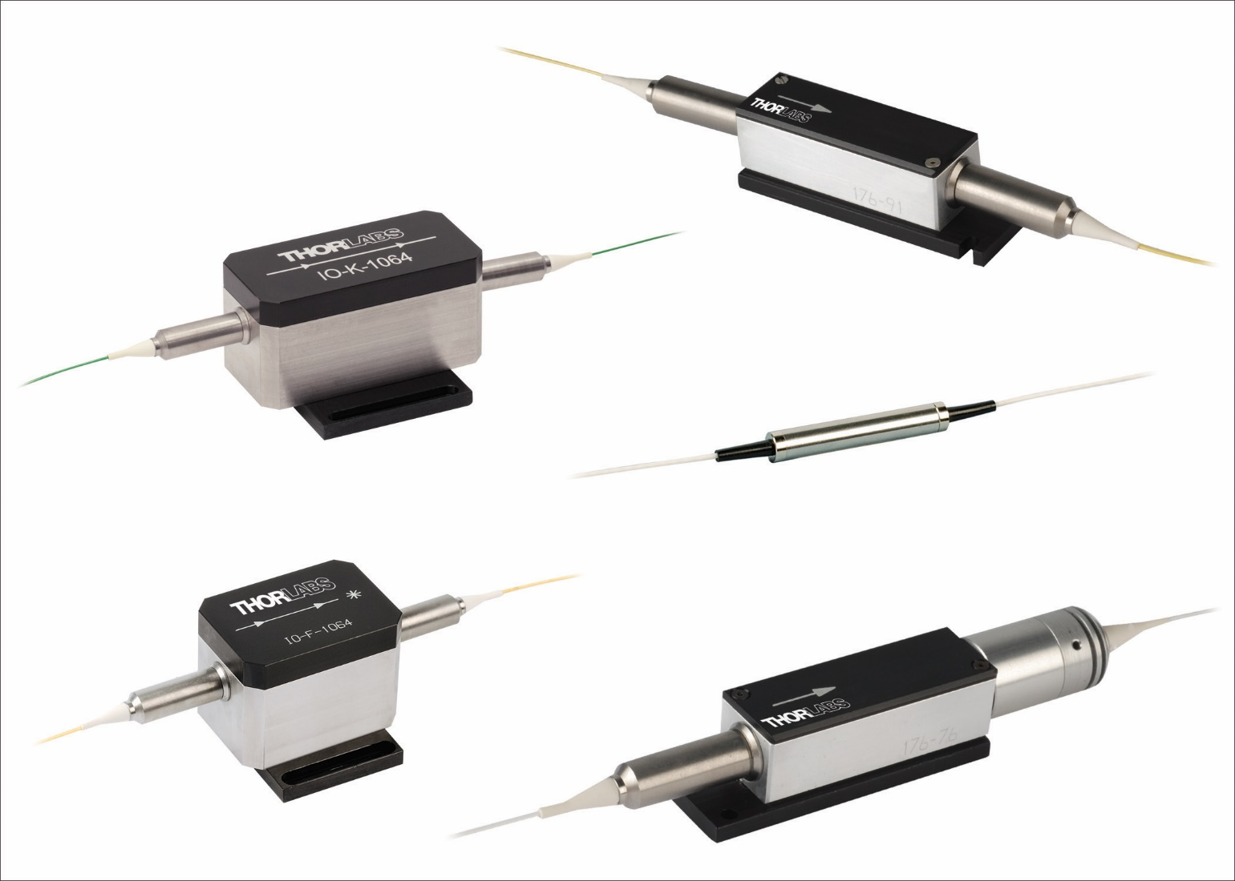
Faraday Rotation
Fiber optical isolators using Faraday rotation
Courtesy of Thorlabs

Slide 4
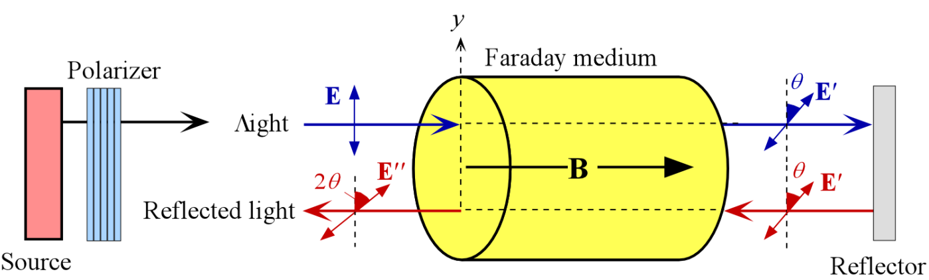
Faraday Effect (Rotation)
The sense of rotation of the optical field E depends only on the direction of the magnetic field for a given medium (given Verdet constant). If light is reflected back into the Faraday medium, the field rotates a further θ in the same sense to come out as E′′ with a 2θ rotation with respect to E.

Slide 5
Faraday Effect (Rotation)
Rotation
(radians)
Verdet constant or coefficient (rad B⁻¹ m⁻¹)
θ = VBL
Magnetic field (T)
Length of medium (m)

Slide 6
Verdet Constant for the Faraday Effect
Material | Quartz 589 nm | Tb₃Ga₅O₁₂ 633 nm | ZnS 589 nm | ZnTe 633 nm | NaCl 589 nm | Crown glasses 633 nm | Dense flint glass (SF57) 633 nm
V (rad m⁻¹ T⁻¹) | 4.0 | −134 | 65.8 | 188 | 10 | 4−6 | 20
Large changes and slope
near resonance
Use a medium near resonance

Slide 7
Faraday Effect: Example
Example: Suppose we pass a polarized beam at 633 nm (from a He-Ne laser) through a 5 cm long SF57 dense flint glass rod. If the magnetic field along the rod is 0.7 T, what is the rotation of the optical field?
Solution
At 633 nm, SF57 dense flint glass has V = 20 rad T⁻¹ m⁻¹.
The rotation is θ = VBL
= (20 rad B⁻¹ m⁻¹)(0.7 T)(0.05 m)
= 0.70 rad, or 40°

Slide 8
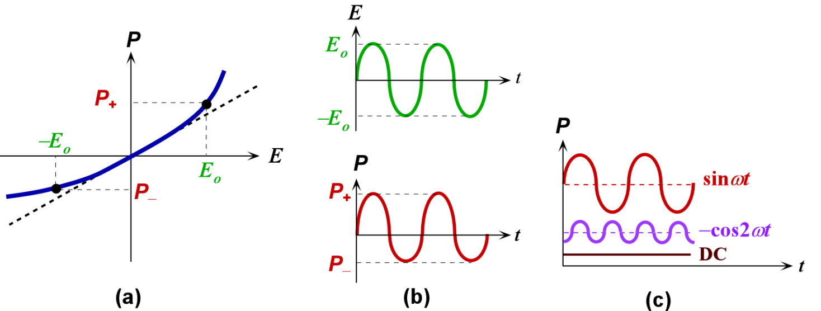
Nonlinear Optics
(a) Induced polarization vs. optical field for a nonlinear medium. (b) Sinusoidal optical field oscillations between ±E_{o} result in polarization oscillations between P₊ and P₋. (c) The polarization oscillation can be represented by sinusoidal oscillations at angular frequencies ω (fundamental), 2ω (second harmonic) and a small DC component.

Slide 9
Nonlinear Optics
P = ε_{o}χ₁E + ε_{o}χ₂E² + ε_{o}χ₃E³
χ₁ = Linear susceptibility
χ₂ = Second-order susceptibility
χ₁ = Third order susceptibility
E = Excitation at frequency ω
E = E_{o}sin(ωt)

Slide 10
P = Response
E = Excitation at frequency ω
E = E_{o}sin(ωt)
P = ε_{o}χ₁E + ε_{o}χ₂E²
P = ε_{o}χ₁E_{o}sin(ωt) − ¹/₂ε_{o}χ₂E_{o}cos(2ωt) + ¹/₂ε_{o}χ₂E_{o}
Same frequency as excitation
ω
Double the frequency as excitation
2ω
DC term
“Permanent polarization”

Slide 11
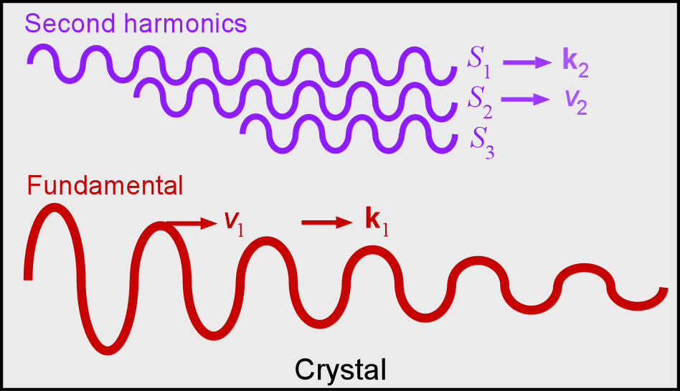
Second Harmonic Generation (SHG)
Phase Matching
As the fundamental wave propagates, it periodically generates second harmonic waves (S₁, S₂, S₃, ...) and if these are in phase then the amplitude of the second harmonic light builds up

Slide 12
Second Harmonic Generation (SHG)
Phase Matching
n_{e}(2ω) = n_{o}(ω)
SHG efficiency depends on phase matching: n(ω) = n(2ω)
Use a birefringent crystal
Suppose that along a certain crystal direction at an angle θ to the optic axis, n_{e}(2ω) at the second harmonic is the same as n_{o}(ω) at the fundamental frequency: n_{e}(2ω) = n_{o}(ω)
This is called index matching and the angle θ is the phase matching angle

Slide 13
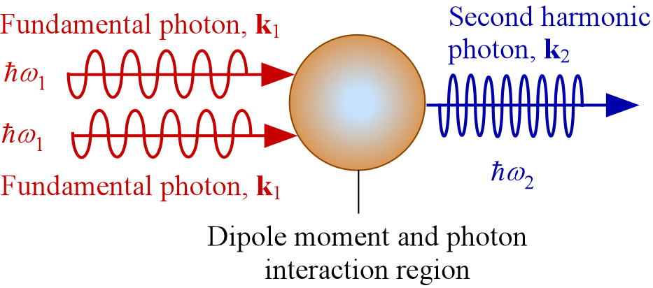
Second Harmonic Generation (SHG)
The Photonic View
hk₁ + hk₁ = hk₂
Conservation of momentum
hω₁ + hω₁ = hω₂
Conservation of energy

Slide 14
Second Harmonic Generation (SHG)
The Photonic View
hω₁ + hω₁ = hω₂
hk₁ + hk₁ = hk₂
ω₂ = 2ω₁
k₂ = 2k₁
Frequency doubling
Phase matching
n (2ω) = n (ω)

Slide 15
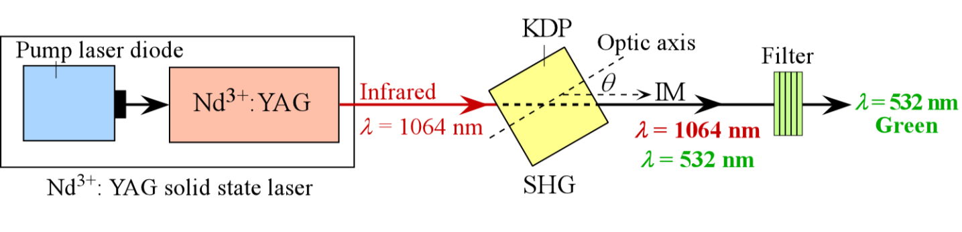
Second Harmonic Generation
SHG
A simplified schematic illustration of optical frequency doubling using a KDP (potassium dihydrogen phosphate) crystal. IM is the index-matched direction at an angle θ (about 35°) to the optic axis along which n_{e}(2ω) = n_{o}(ω). The focusing of the laser beam onto the KDP crystal and the collimation of the light emerging from the crystal are not shown

Slide 16
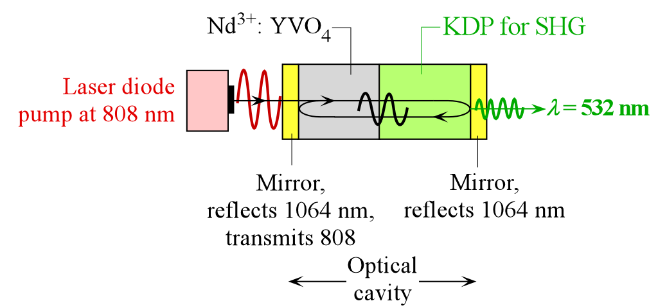
Green Laser Pointers
Typical SHG-based green laser principle. The KTP crystal is next to the Nd³⁺:YVO₄ crystal and both inside the laser optical cavity. The end mirrors reflect 1064 nm radiation and hence allow the 1064 nm radiation to build-up in the cavity

